Slide 1
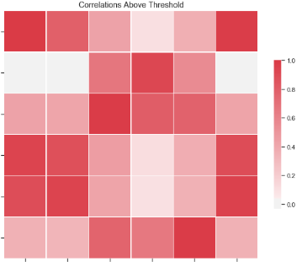
Average Student Allowance
Lodged bonds by region
Geometric mean rents by region
Date
Population Estimate 15-39
Geometric mean rents
by territorial authority
Approved Work Visa
Synthetic lower quartile rents by region
Synthetic lower quartile rents by territorial authority
Average Student Allowance
Regional GDP
Average Accommodation

Slide 2
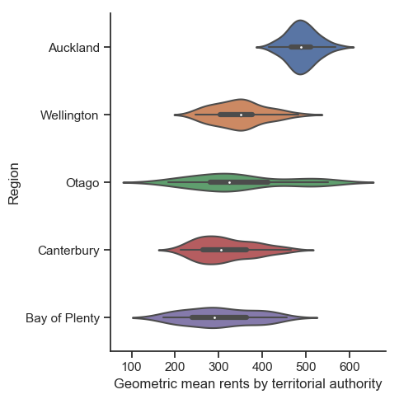
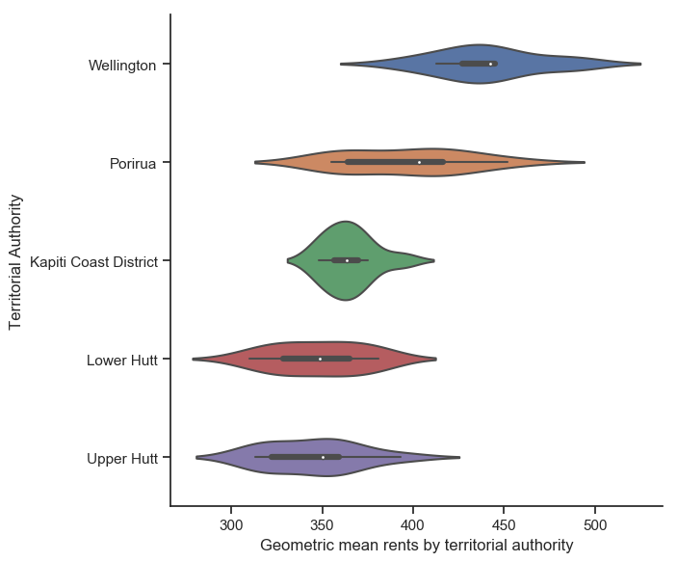
Why are Wellington’s rental prices so high?
Prediction model based on gradient boost regression
Rental bond data from MBIE and other public datasets
Relative Feature Importance for predicting geometric mean rents by territorial authority
 | NZ |  | Wellington |  | Auckland
1 | TA | 100% | Lodged bonds by TA | 100% | Lodged bonds by TA | 100%
2 | Lodged bonds by TA | 67.37% | TA | 64.36% | TA | 62.63%
3 | Student Enrolments | 37.36% | No. of Residential Building Consents | 33.91% | Date | 27.03%
4 | Regional GDP | 36.70% | Approved Student Visa | 28.72% | Approved Student Visa | 26.39%
5 | No. of Residential Building Consents | 26.05% | Date | 26.02% | No. of Residential Building Consents | 25.52%
6 | Date | 19.98% | Student Enrolments | 22.36% | Median Weekly Earnings 20-29 | 21.39%
7 | Region | 13.77% | Median Weekly Earnings 20-29 | 22.36% | CPI | 20.80%
8 | CPI | 11.39% | CPI | 22.26% | Mortgage floating rate | 15.63%
9 | Approved Student Visa | 8.41% | Mortgage 2 year fixed rate | 13.92%
Top 5 Rental Markets by Region – 2016-2018
Top 5 Rental Markets in Wellington Region – 2016-2018
Avg time to Kelburn campus *
0
26-50 min
45-1h 10min
20-40 min
35-55 min
*by car on weekdays leaving @ 8am
Wellington is the second most expensive rental market in NZ, second only to Auckland. It is not uncanny that the top 5 most expensive rental markets also correspond with the top 4 out of 5 regions with the most lodged bonds indicating high demand vs short supply is a strong driver to increasing rent prices. Despite common belief due to the recent rise of Wellington’s rent prices, the average rent price is still a long way off matching Auckland’s rent prices comparing their rental distributions. Additionally, renting in Lower and Upper Hutt seems like the best compromise in saving money with a manageable commute where rental prices in Porirua and Kapiti remain quite high with a hefty commute.
From the table of relative feature importances above we can see that the largest driving factor of Wellington and Auckland’s high rent prices is the shortage of rental properties as indicated by the decrease in lodged bonds and the no. of residential building consents. This may be due to tighter restrictions and standards in light of the 2016 Kaikoura earthquake which greatly impacted Wellington. The fact that the number of approved student visas is the 4th most important feature suggests that rental demand is also driven by the increase in international students. Additionally, rental costs are also rising due to increased living costs as indicated by median weekly earnings and inflation (CPI) as well as increasing costs on landlords as indicated by mortgage rates.
Top 5 Student Enrolments by Region – 2016-2018
Top 5 Lodged Bonds by Region – 2016-2018
Wellington’s Geometric mean rents vs lodged bonds by territorial authority
Surprisingly, Wellington’s student enrolment numbers are slightly higher than that of Auckland’s however these numbers includes polytechnics, institutes of technology and wanangas as well. However, observing the trend of student enrolments in Wellington more closely, the number of student enrolments in Wellington has actually dropped significantly in the last year from 110 405 students in Mar 2017 to 106 493 students in Mar 2018 despite increasing rent prices.
Geometric mean rents vs student enrolments in Wellington
Wellington’s Geometric mean rents vs Number of Residential Building Consents

